Slide 1
C# Programming
Presented by Long nguyen

Slide 2
content
Decision making
Loops
Array
Properties
Exercise

Slide 3
Decision making

Slide 4
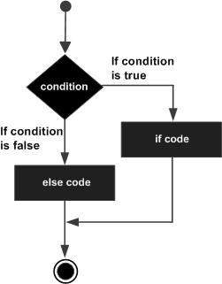
if … else
if(boolean_expression) {
/* statement(s) will execute if the boolean expression is true */
}
else {
/* statement(s) will execute if the boolean expression is false */
}
public void Sub (int a, int b){
int result = 0;
if(a > b) {
result = a - b;
}
else {
result = b - a;
}
}

Slide 5
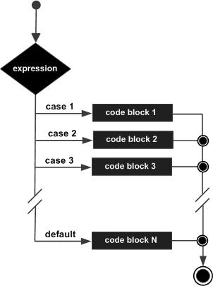
switch statement
switch(expression){
case constant-expression :
statement(s);
break; /* optional */
case constant-expression :
statement(s);
break; /* optional */
/* you can have any number of case statements */
default : /* Optional */
statement(s);
}

Slide 6
switch statement
Example
char grade = 'B';
switch (grade) {
case 'A':
Console.WriteLine("Excellent!");
break;
case 'B':
case 'C':
Console.WriteLine("Well done");
break;
case 'D':
Console.WriteLine("You passed"); break;
case 'F':
Console.WriteLine("Better try again"); break;
default:
Console.WriteLine("Invalid grade"); break;
}

Slide 7
loop

Slide 8
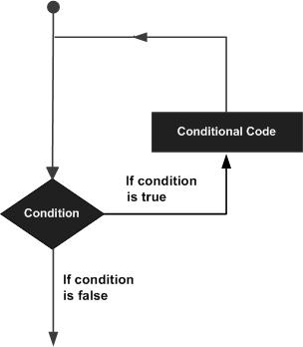
General
A loop statement allows us
to execute a statement or group
of statements multiple times.
C# provides following types of
loop to handle looping requirements
while loop
for loop
Do … while loop

Slide 9
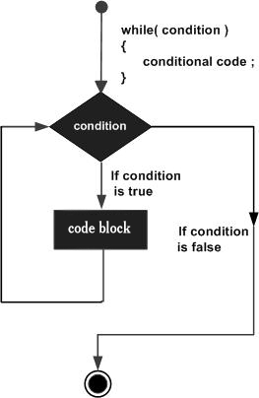
While loop
Syntax:
while(condition) {
statement(s);
}
using System;
namespace Loops {
class Program {
static void Main(string[] args) {
int a = 1;
/* while loop execution */
while (a < 10) {
Console.WriteLine("value of a: {0}", a);
a++;
}
Console.ReadLine();
}
}
}

Slide 10
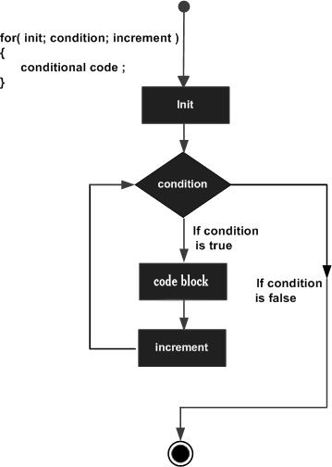
For loop
for ( init; condition; increment )
{
statement(s);
}
using System;
namespace Loops {
class Program {
static void Main(string[] args) {
/* while loop execution */
for (int a = 1; a < 10; a = a + 1)
{
Console.WriteLine("value of a: {0}", a);
}
Console.ReadLine();
}
}
}

Slide 11
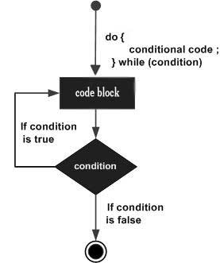
Do…while loop
do{
statement(s);
} while( condition );
using System;
namespace Loops {
class Program {
static void Main(string[] args) {
int a = 1;
/* while loop execution */
do {
Console.WriteLine("value of a: {0}", a);
a++;
} while (a < 10)
Console.ReadLine();
}
}
}

Slide 12
Loop Control Statements
Loop control statements change execution from its normal sequence.
When execution leaves a scope, all automatic objects that were created in that scope are destroyed.
C# provides the following control statements:
break statement: Terminates the loop or switch statement and transfers execution to the statement immediately following the loop or switch
continue statement: Causes the loop to skip the remainder of its body and immediately go to next condition.

Slide 13
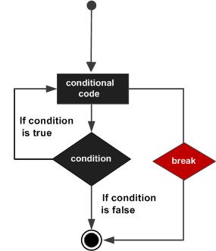
break statement
using System;
namespace Loops {
class Program {
static void Main(string[] args) {
int a = 1;
/* while loop execution */
while (a < 10) {
Console.WriteLine("value of a: {0}", a);
a++;
if (a > 5) {
/* terminate the loop using break statement */ break;
}
}
Console.ReadLine();
}
}
}

Slide 14
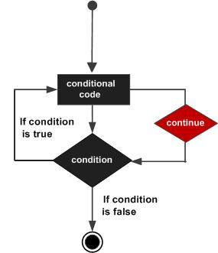
continue statement
using System;
namespace Loops {
class Program {
static void Main(string[] args) {
int a = 1;
/* while loop execution */
while (a < 10) {
if (a == 5) {
/* skip the iteration*/
a = a + 1;
continue;
}
Console.WriteLine("value of a: {0}", a);
a++;
}
Console.ReadLine();
}
}
}

Slide 15
Array

Slide 16
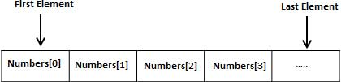
array
Declaring Arrays: datatype[] arrayName;
Example: double[] balance;
Initializing an Array: double[] balance = new double[10];
Assigning Values:
balance[0] = 4500.0;
int [] marks = new int[] { 99, 98, 92, 97, 95};

Slide 17
Accessing Array Elements
Access array element: <array-name>[index]
using System;
namespace ArrayApplication {
class MyArray {
static void Main(string[] args) {
int [] n = new int[3] {1, 2, 3};
/* output each array element's value */
for (int j = 0; j < n.Length - 1; j++ ) {
Console.WriteLine("Element[{0}] = {1}", j, n[j]);
}
Console.ReadKey();
}
}
}

Slide 18
Properties

Slide 19
Properties
Properties are named members of classes, structures, and interfaces.
Member variables or methods in a class or structures are called Fields.
Properties are an extension of fields and are accessed using the same syntax
Properties do not name the storage locations. Instead, they have accessors that read, write, or compute their values.

Slide 20
Accessor
The accessor of a property contains the executable statements that helps in getting (reading or computing) or setting (writing) the property.
Ex:
private string _code = “”;
public string Code
{
get {
return _code;
}
set {
_code = value;
}
}
Can not access this field from another class.
Accessor

Slide 21
Usage
using System;
namespace PropertiesUsage {
class Student {
private string name = “”;
// Declare a Name property of type string:
public string Name {
get {
return name;
} set {
name = value;
}
}
}
class Demo {
static void Main(string[] args) {
Student st = new Student();
st.Name = “Nguyen Van A”;
}
}
}

Slide 22
Q&A

Slide 23
THANK YOU!

